Slide 1
Genetic Algorithm Part 2
By: Marcel Englmaier &
Michael Sharp

Slide 2
Process
Make Adam&Eve Generation
Begin giant loop
Test if target has been reached(then break out)
Create babies from parents based on random fitness level
Crossover chromosomes
Mutate babies
Parents become babies, then repeat

Slide 3
AssignFitness
Three methods
BintoDec
Parse
AssignFitness
0: 0000
1: 0001
2: 0010
3: 0011
4: 0100
5: 0101
6: 0110
7: 0111
8: 1000
9: 1001
+: 1010
-: 1011
*: 1100
/: 1101
0110 1010 0101 1100 0100 1101 0010 1010 0001
6 + 5 * 4 / 2 + 1

Slide 4
MakeMeABaby()
Make a random float from 0-totalFitness(slice)
Loop for population
If the currentFitness >= slice
baby=parent
--Else current parent is unfit, move on to next one

Slide 5
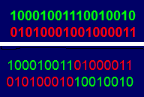
Crossover()
Take in two babies
Randomly choose a bit in the bitstring(if any at all)
For all bits after that chosen bit
Swap baby 1 bits with baby2 bits

Slide 6

Mutate()
For each bit in the bitstring
If a random value(0-1) < MutationRate)
Flip dat bit

Slide 7
Parameters Used
Only 3 Generations
Target value of 200
Why? Because reasons, that’s why.
Actually, we had no idea.
Timewise, 3 makes sense
Difficulty wise, as you scale, the target becomes relatively smaller and you can find solution within Adam&Eve Generation ->Not the goal

Slide 8
More Parameters
Bitlength of 20
Genelength of 4(because that’s how many there actually are)
Crossover rate of 0.7 because that’s what a website told us is good
Mutation rate of 0.001 because that website was not shady at all and had good advice

Slide 9
Timings
Subjects | Sequentical Nano Seconds | Parallel Nano Seconds
10 | 33 | 35
100 | 348 | 351
1k | 11109 | 11250
10k | 977719 | 974163
100k | 95578030 | 95233035
1mil Borked it aka Torque stopped it because it hit WallTime 3600(1 hour)

Slide 10
Let’s analyze
On average up to 1k, sequential was faster. After that, parallel is faster
Why? Overhead, massive overhead. Also, we’re only running on 16 cores on 1 node

Slide 11
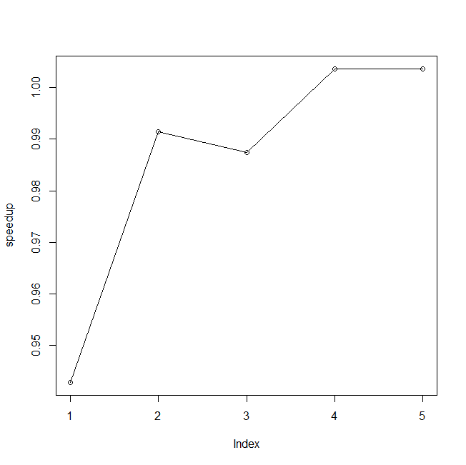

Speedup
HEY! That’s a graph of something
kinda important!

Slide 12
How did we parallelize?
Just a bunch of # pragma omp parallel for
things everywhere. Why? Because we had a bunch(3) of self-contained for loops, that’s why.

